Slide 1
Component-based software Development

Slide 2
Topics covered
Components and component models
The CBSE process
Component composition

Slide 3
Component-based development
Component-based software engineering (CBSE) is an approach to software development that relies on software reuse.
It emerged from the failure of object-oriented development to support effective reuse. Single object classes are too detailed and specific.
Components are more abstract than object classes and can be considered to be stand-alone service providers.

Slide 4
CBSE essentials
Independent components specified by their interfaces.
Component standards to facilitate component integration.
Middleware that provides support for component inter-operability.
A development process that is geared to reuse.

Slide 5
CBSE and design principles
Apart from the benefits of reuse, CBSE is based on sound software engineering design principles:
  Components are independent so do not interfere with each other;
  Component implementations are hidden;
  Communication is through well-defined interfaces;
  Component platforms are shared and reduce development costs.

Slide 6
CBSE problems
Component trustworthiness - how can a component with no available source code be trusted?
Component certification - who will certify the quality of components?
Emergent property prediction - how can the emergent properties of component compositions be predicted?
Requirements trade-offs - how do we do trade-off analysis between the features of one component and another?

Slide 7
Components
Components provide a service without regard to where the component is executing or its programming language
  A component is an independent executable entity that can be made up of one or more executable objects;
  The component interface is published and all interactions are through the published interface;

Slide 8
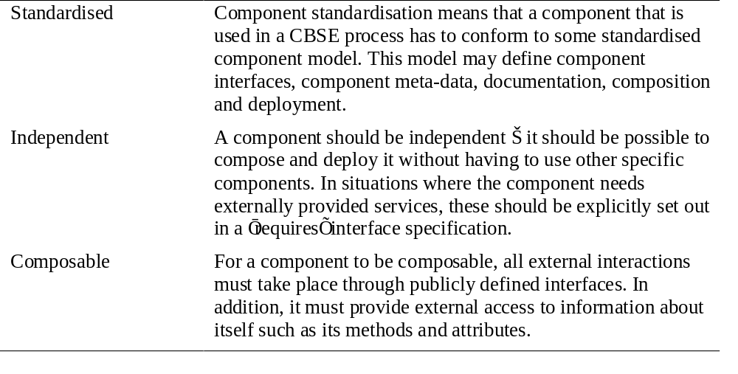
Component characteristics 1

Slide 9
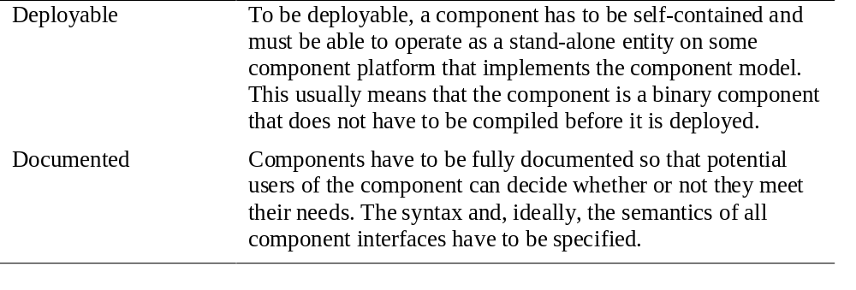
Component characteristics 2

Slide 10
Component interfaces
Provides interface
  Defines the services that are provided by the component to other components.
Requires interface
  Defines the services that specifies what services must be made available for the component to execute as specified.

Slide 11
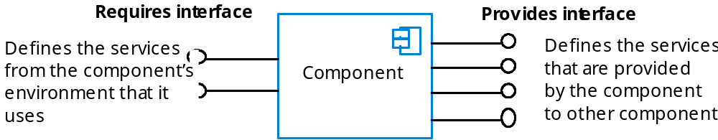
Component interfaces

Slide 12
Component development for reuse
Components for reuse may be specially constructed by generalising existing components.
Component reusability
  Should reflect stable domain abstractions;
  Should hide state representation;
  Should be as independent as possible;
  Should publish exceptions through the component interface.
There is a trade-off between reusability and usability
  The more general the interface, the greater the reusability but it is then more complex and hence less usable.

Slide 13
Changes for reusability
Remove application-specific methods.
Change names to make them general.
Add methods to broaden coverage.
Make exception handling consistent.
Add a configuration interface for component adaptation.
Integrate required components to reduce dependencies.

Slide 14
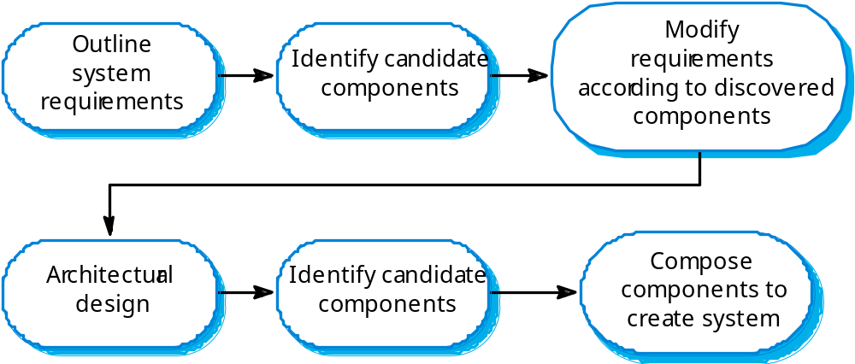
The CBSE process

Slide 15

The component identification process

Slide 16
Key points
CBSE is a reuse-based approach to defining and implementing loosely coupled components into systems.
A component is a software unit whose functionality and dependencies are completely defined by its interfaces.
A component model defines a set of standards that component providers and composers should follow.
During the CBSE process, the processes of requirements engineering and system design are interleaved.

Slide 17
Key points
Component composition is the process of ‘wiring’ components together to create a system.
When composing reusable components, you normally have to write adaptors to reconcile different component interfaces.
When choosing compositions, you have to consider required functionality, non-functional requirements and system evolution.

